Slide 1
PROJECT MANAGEMENT SYSTEM
CREATED BY:
Prajapati Dev
Prajapati Rahul

Slide 2
INTRODUCTION
An issue tracking system (ITS) is an online web application that allows a complete life-cycle management of Project in an organization. Using this web application admin manage the different level of user that involved in a any project development.

Slide 3

INDEX
→Project Profile
→Screen Layout
→Report
→Conclusion

Slide 4
PROJECT PROFILE
→System Requirement
→ Existing System
→ Limitation Of Existing System
→ Proposed System
→ Modules
→ Project Guide

Slide 5
SYSTEM REQUIREMENT
Software Used:-
FrontEnd: Python with Django
BackEnd: MySQL

Slide 6
EXISITING SYSTEM
Currently all the information about projects and issues are manage manually.
Project manager does not keep track of how many issues are still not resolved or pending. Currently issue life cycle is not managed so project manager does not knowledge about issue status report

Slide 7
PROPOSED SYSTEM
The main intention behind the issue tracking system is that to track issue and store the issue information in the database for future reference.
The admin and project manager can fully understand what the status of each issue and whether it is fixed , assigned or wontfix.

Slide 8
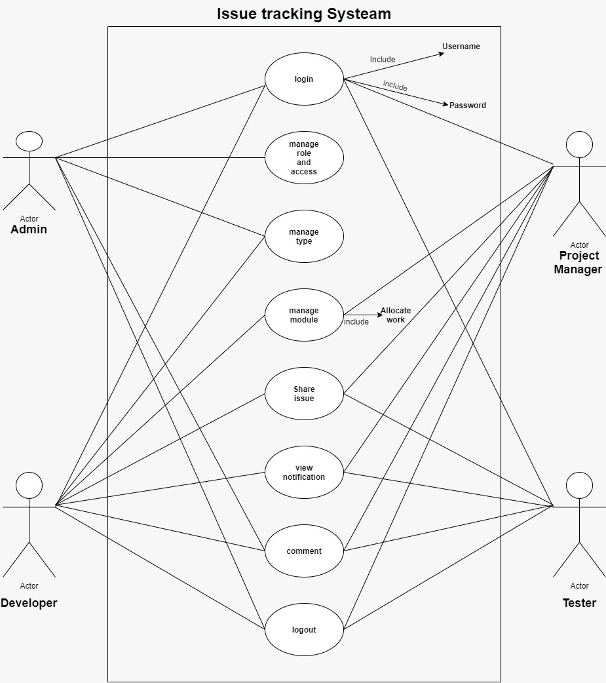
DIAGRAM

Slide 9
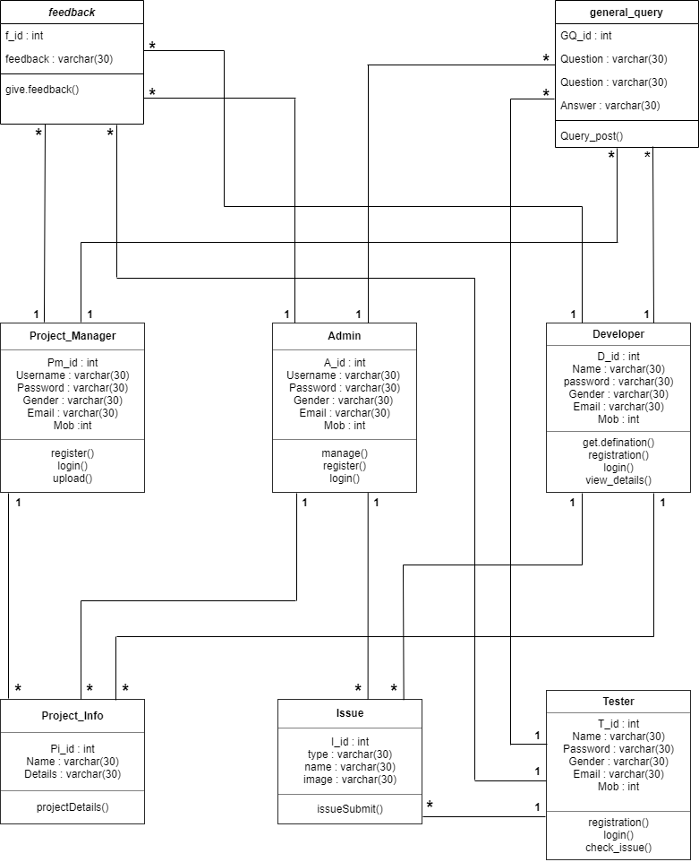
CLASS DIAGRAM

Slide 10
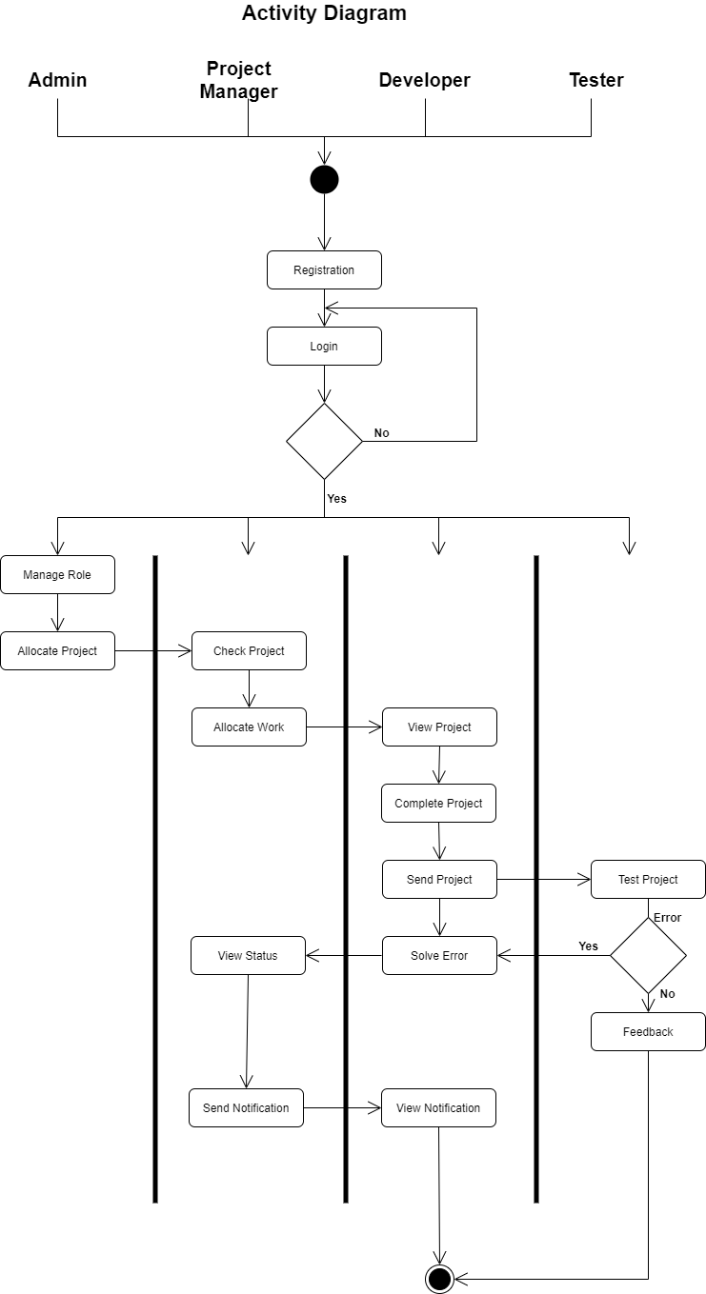
ACTIVITY DIAGRAM

Slide 11
Sequence Diagram
1)Registration Process
2)Login Process
3)Admin To Project manager
4)Project manager To Developer
5)Issue Process
6)Query box

Slide 12
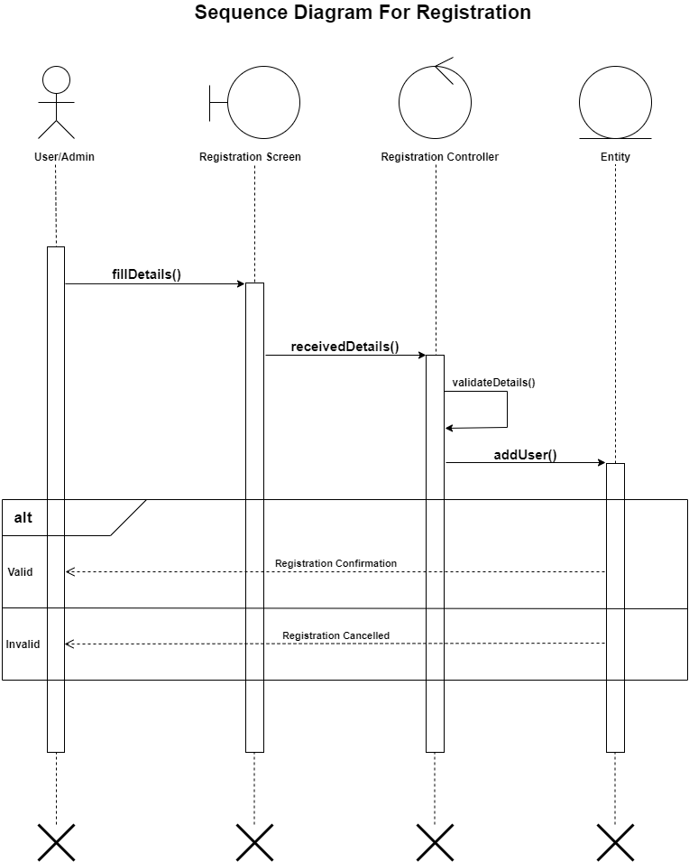
Sequence Diagram For Registration Process

Slide 13
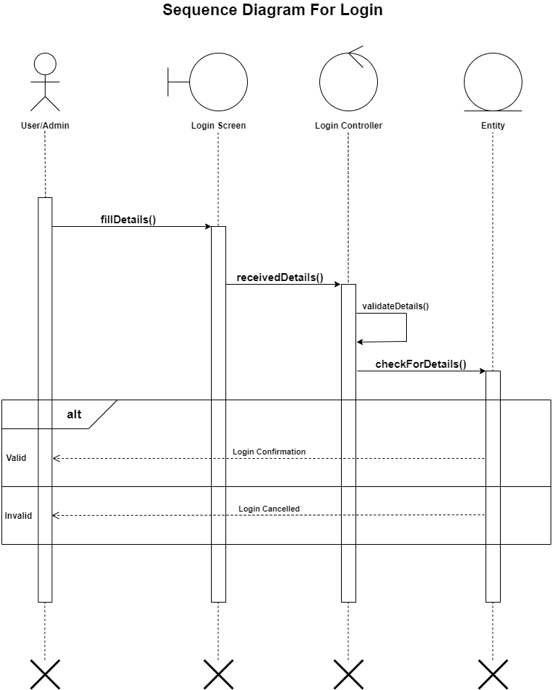
Sequence Diagram For Login Process

Slide 14
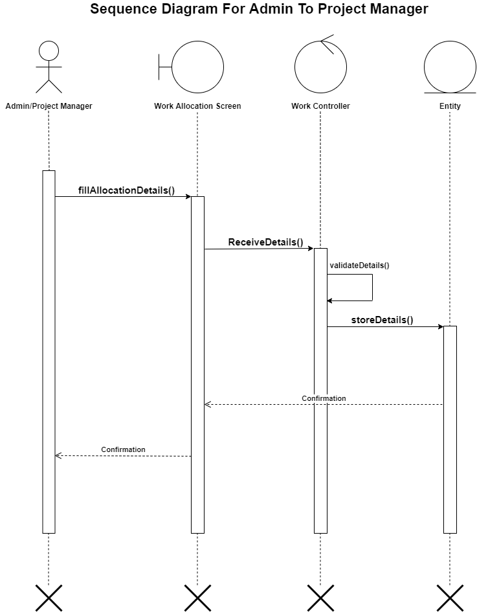
Sequence Diagram For Admin To Project Manager

Slide 15
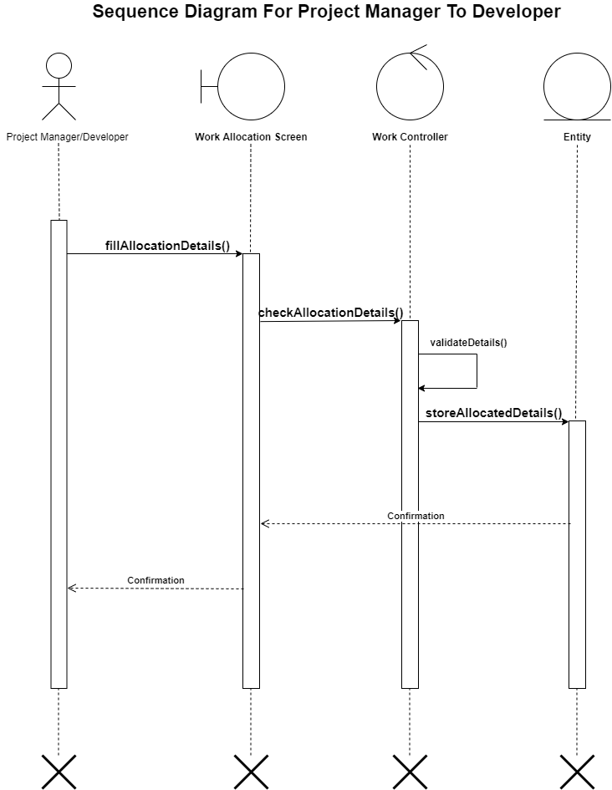
Sequence Diagram For Project Manager To Developer

Slide 16
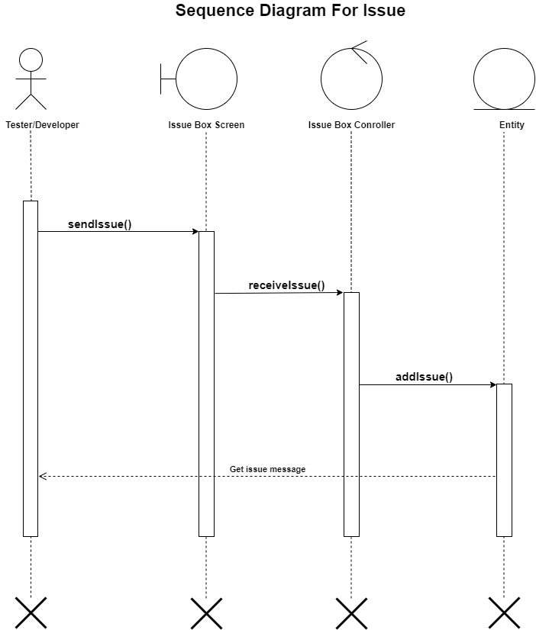
Sequence Diagram For Issue Process

Slide 17
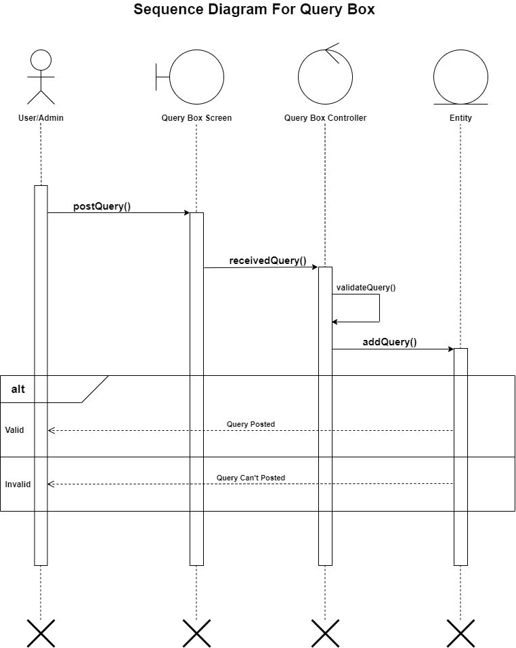
Sequence Diagram For Query Box

Slide 18
State-chart Diagram
1)Registration Process
2)Login Process
3)Allocate work Process
4)Issue Process

Slide 19
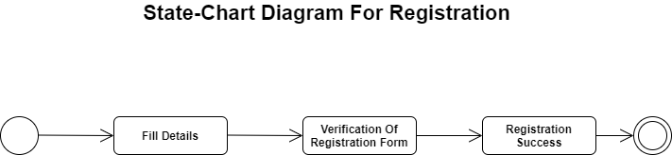
State-Chart Diagram For Registration Process

Slide 20
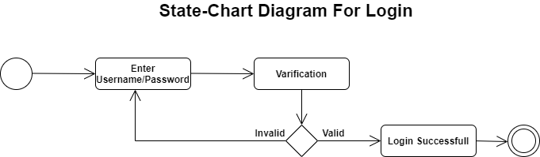
State-Chart Diagram For Login Process

Slide 21
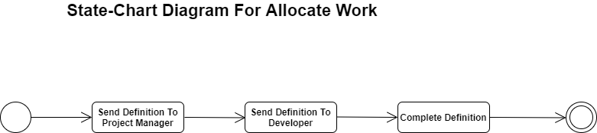
State-Chart Diagram For Allocate Work Process

Slide 22
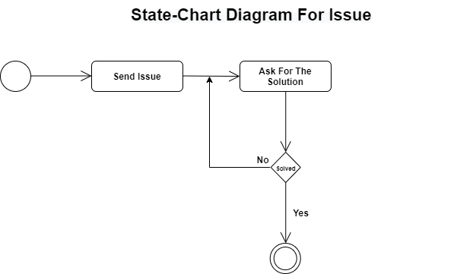
State-Chart Diagram For Issue Process

Slide 23
DATA DICTIONARY
REGISTRATION TABLE
Sr No | Field Name | Datatype | Size | Constraint | Description
1 | R_id | Integer | 3 | Primary Key | This is unique field for Registration Table
2 | Usertype | Varchar | 15
3 | Username | Varchar | 30
4 | Password | Varchar | 30
5 | Gender | Varchar | 30
6 | Email | Varchar | 30
7 | Mob | Integer | 10

Slide 24
ISSUE TABLE:-
Sr No. | Field Name | Datatype | Size | Constraint | Description
1 | I_id | Integer | 3 | Primary Key | This is unique field for Issue Table.
2 | R_id | Integer | 3 | Foreign Key | This is reference field for Registration Table
3 | Issue_type | Varchar | 30
4 | Issue_Name | Varchar | 30
5 | Issue_image | Varchar | 30

Slide 25
Project_Info Table
Sr No. | Field Name | Datatype | Size | Constraint | Description
1 | Pi_id | Integer | 3 | Primary Key | This is unique field for Project_Info Table.
2 | R_id | Integer | 3 | Foreign Key | This is reference field for Registration Table
3 | Name | Varchar | 100
4 | Details | Varchar | 300

Slide 26
GENERAL QUERY TABLE:-
Sr No. | Field Name | Datatype | Size | Constraint | Description
1 | Gq_id | Integer | 3 | Primary Key | This is unique field for General_Query Table.
2 | R_id | Integer | 3 | Foreign Key | This is reference field for Registration Table
3 | Question | Varchar | 300
4 | Answer | Varchar | 300

Slide 27
FEEDBACK TABLE
Sr No. | Field Name | Datatype | Size | Constraint | Description
1 | F_id | Integer | 3 | Primary Key | This is unique field for Feedback Table.
2 | R_id | Integer | 3 | Foreign Key | This is reference field for Registration Table
3 | Feedback | Varchar | 30

Slide 28
MODULES
Admin
Project Manager
Developer
Tester
Issue
Query

Slide 29

ADMIN
Admin can manage the users and its role into the system.
Login : Admin can login into the system by entering valid username and password to access the system functionality.
Forget Password : User can recover password by OTP.
Edit Profile : User can change his/her profile information.
Logout : After operation complete user logout from system

Slide 30
PROJECT MANAGER
Project Manager is responsible to manage the complete life cycle of the project.
Login - Project manager can login into the system by entering valid username and password to access the system functionality.
Forgot password - User can recover password by OTP.
View and Manage Project : Project Manage can view the project that are allocated to him and also able to update Project Status.
Manage Modules : Project Manage can create a new task or module into the system and also able to allocate that to the developer.

Slide 31
CONTI...
View Notification : When New Project is allocated by the admin then automatic system generated notification is send to the Project manager into the web application and also email-id.
Generate Report : Project Manager can generate the different Types of Reports into the system.
Logout : After operation complete user logout from system.

Slide 32
DEVELOPER
Developer is responsible to manage the module that are allocated to him for development.
Login : Developer can login into the system by entering valid username and password to access the system functionality.
View And Project : Developer can view the Projects that are allocated to him and also able to update status for that Project.
View Notification : When New Module is allocated to the developer then automatic system generated notification is send to the Project manager into the web application and also email-id.

Slide 33
CONTI...
View Issue Details: Developer can view the issue details that are allocated to him to resolve.
Logout : After operation complete user logout from system

Slide 34
TESTER
Tester can create and update the basic details about the Issue.
Login - Tester can login into the system by entering valid username and password to access the system functionality.
Forgot password - User can recover password by OTP.
View Project And Notification :- Tester can view the project details. When New Project is allocated to the tester then system generated notification is send into the web application and also email-id.

Slide 35
CONTI...
Manage Issue Details - Tester can create and update the basic details about the Issue.
Manage Issue Status - Tester can update the Issue status.
Logout - After operation complete user logout from system.

Slide 36
ISSUE
After the testing application by tester if tester has any issue during run that application then tester will inform that issue to developer through our feature issue box.

Slide 37
QUERY
We have design the query box to facilite our staff members to solve their all kind of problems where they can put their queries in the query box. Where everyone can answer or reply who knows the solution of the same.
So we have design such kind of query where everybody is free to put their query & get answers and everyone can get the quick solution of their problems.

Slide 38
PROJECT GUIDE
Internal Guide
Prof. Purna Tanna

Slide 39
SCREEN LAYOUT

Slide 40
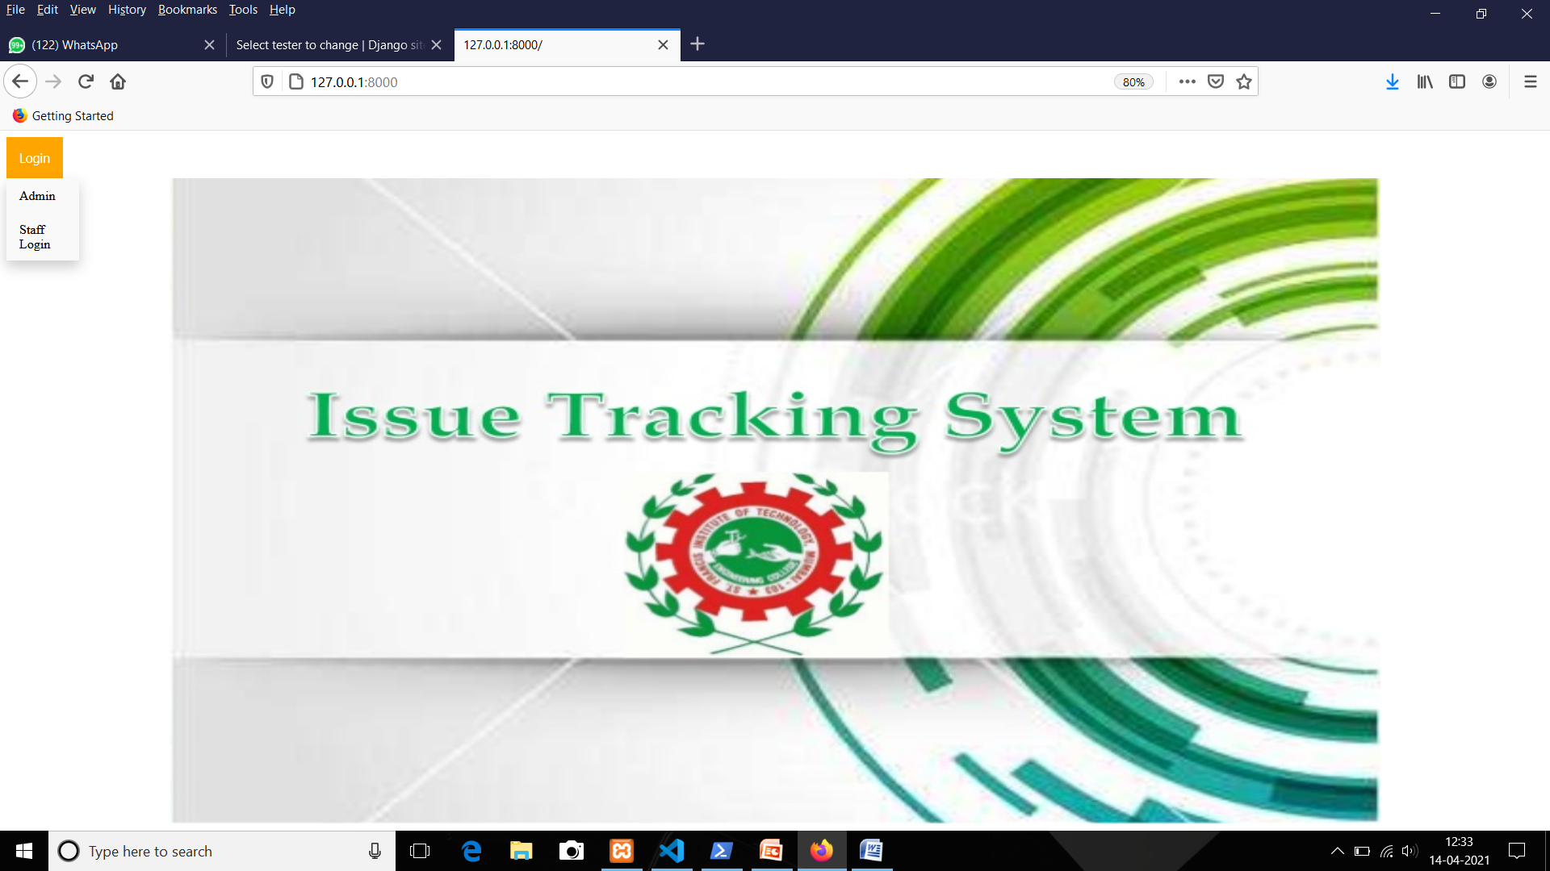
HOME PAGE

Slide 41
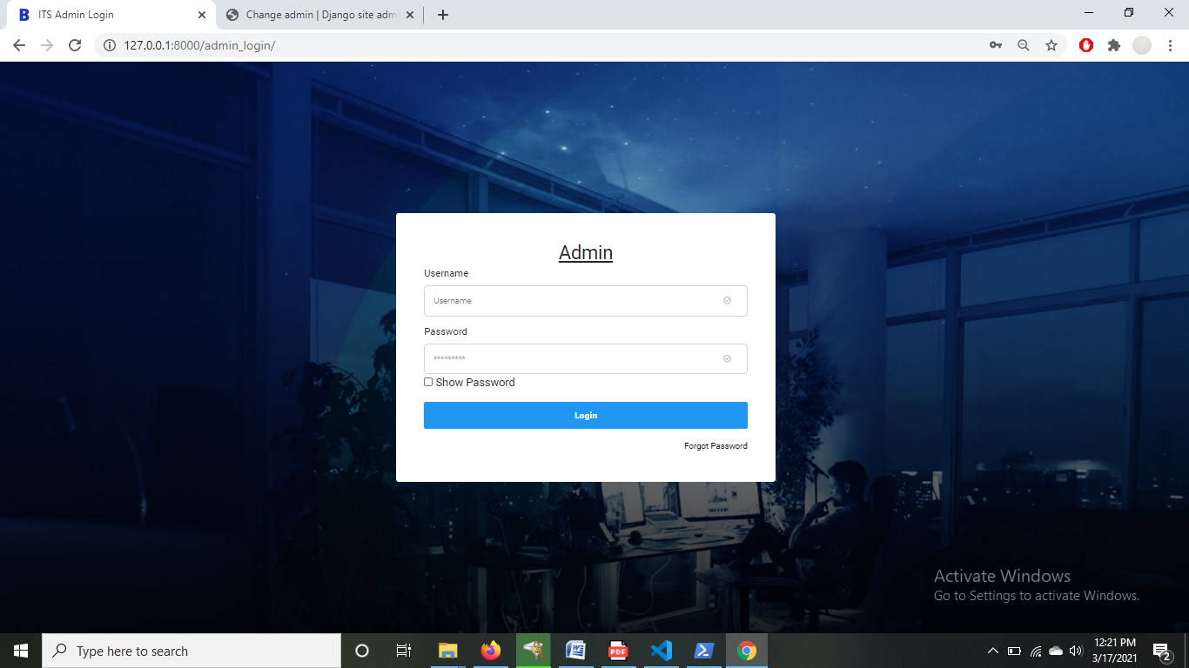
Admin Login Page

Slide 42
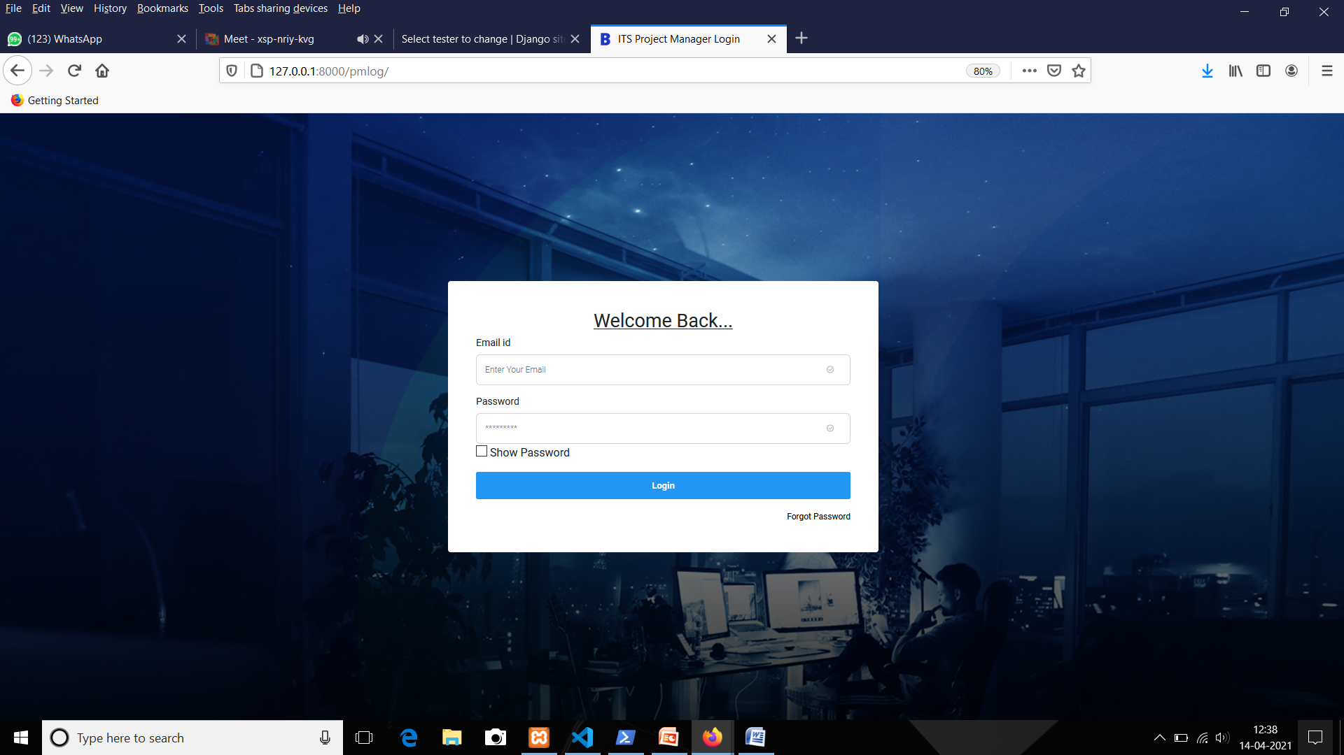
Staff Login Page

Slide 43
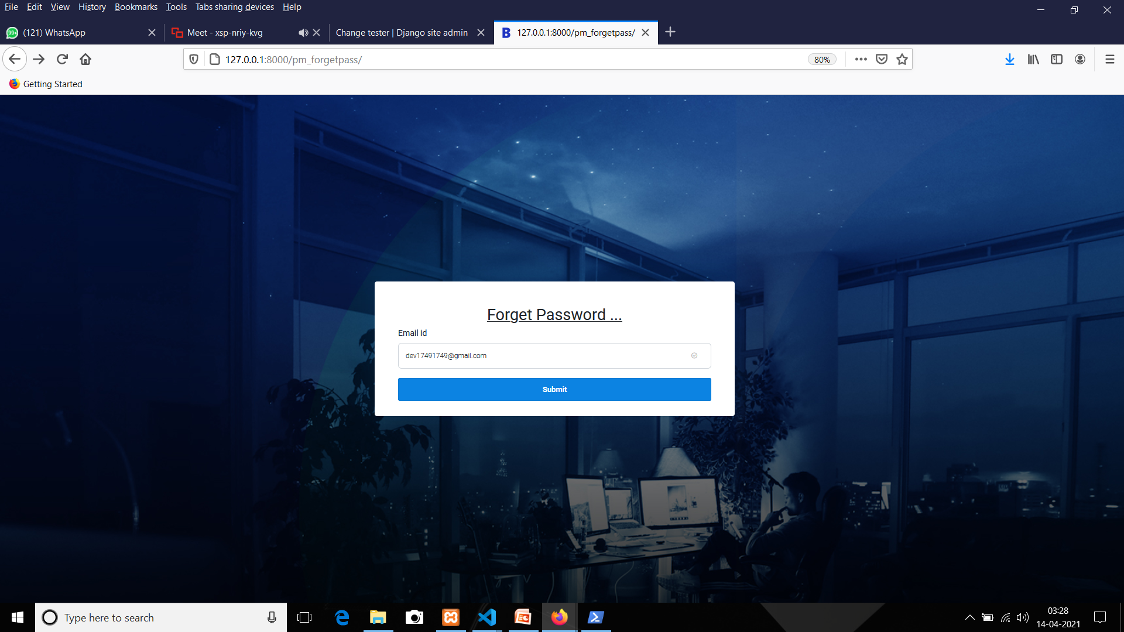
Forgot Password

Slide 44
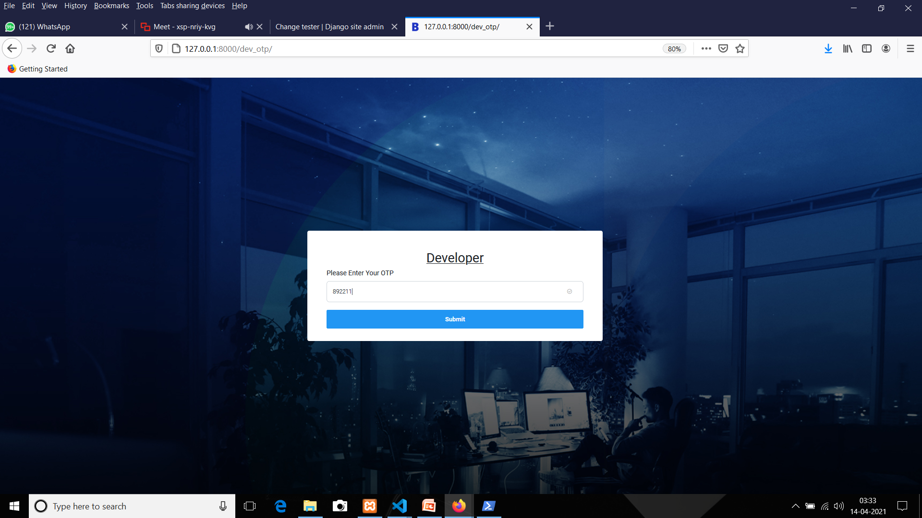
OTP Page

Slide 45
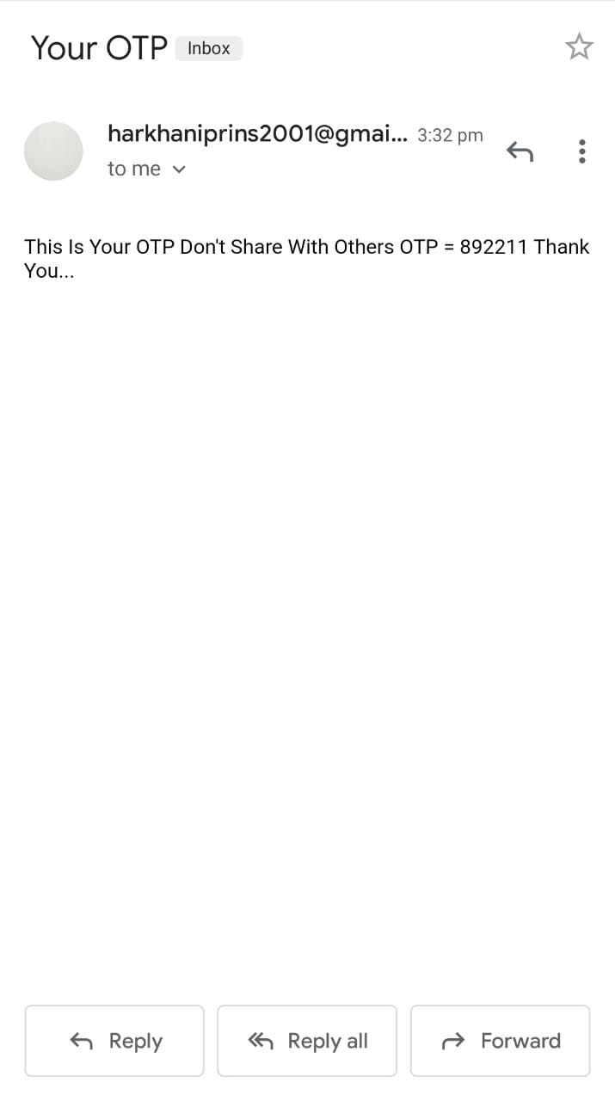
Generate Mail For OTP

Slide 46
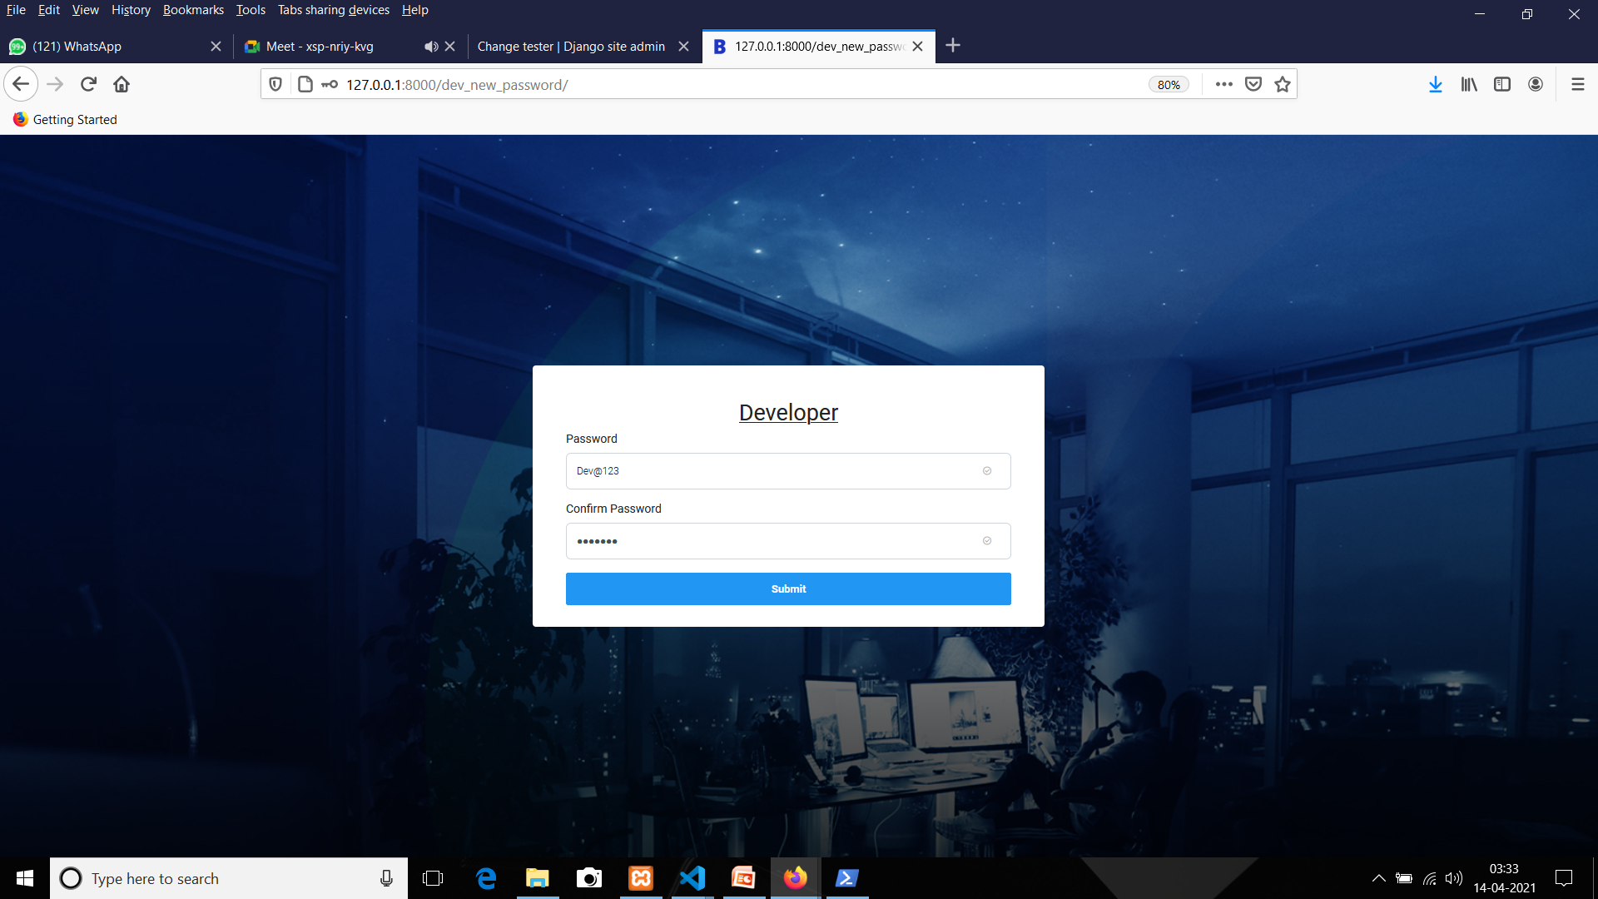
Create A New Password

Slide 47
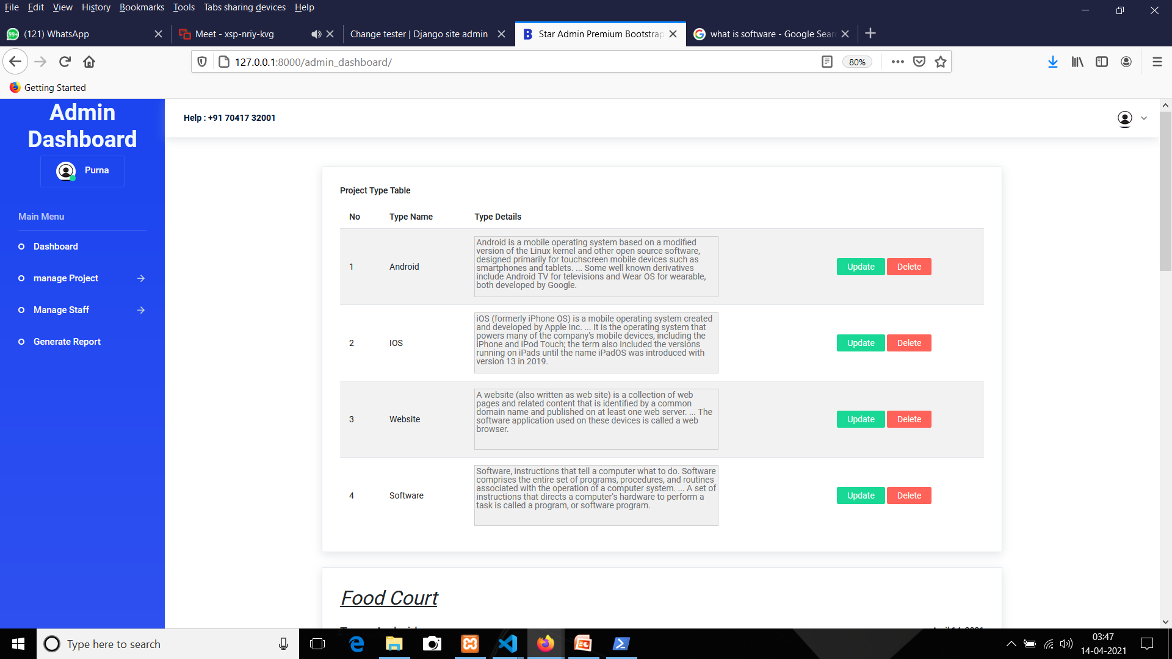
Admin
Admin Dashboard

Slide 48
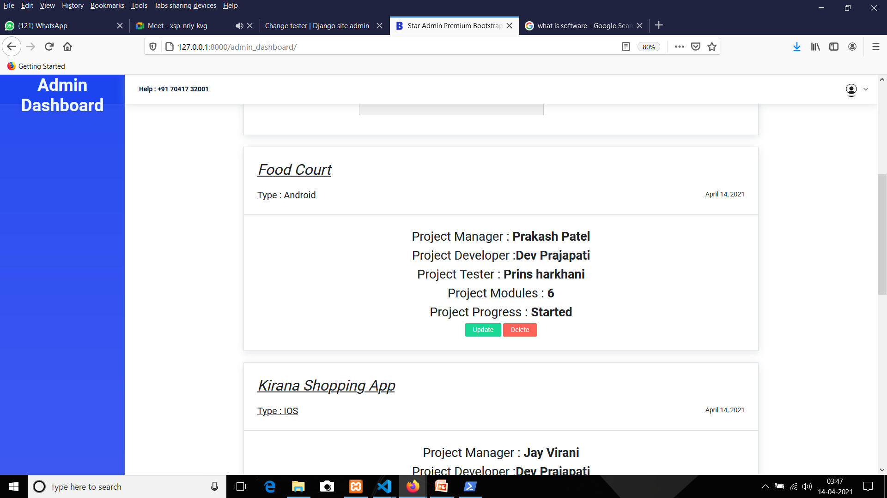
CONTI...

Slide 49
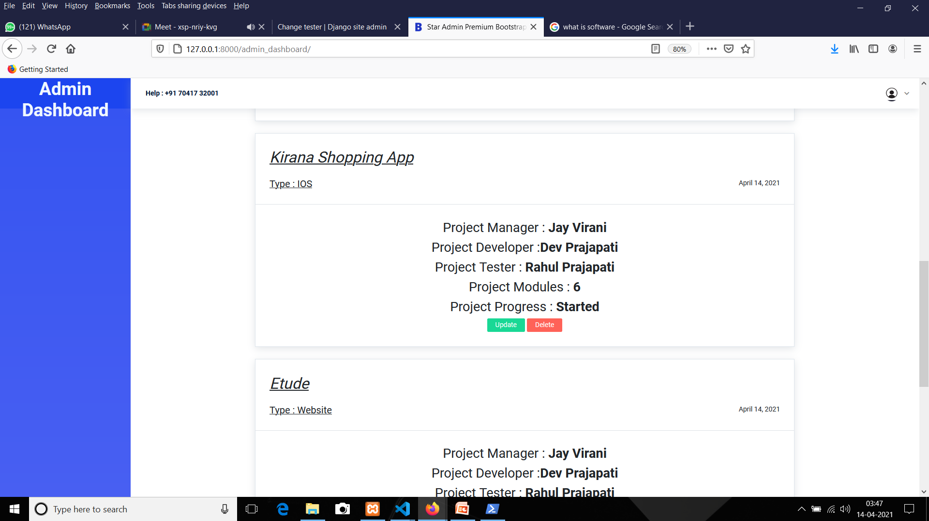
CONTI...

Slide 50
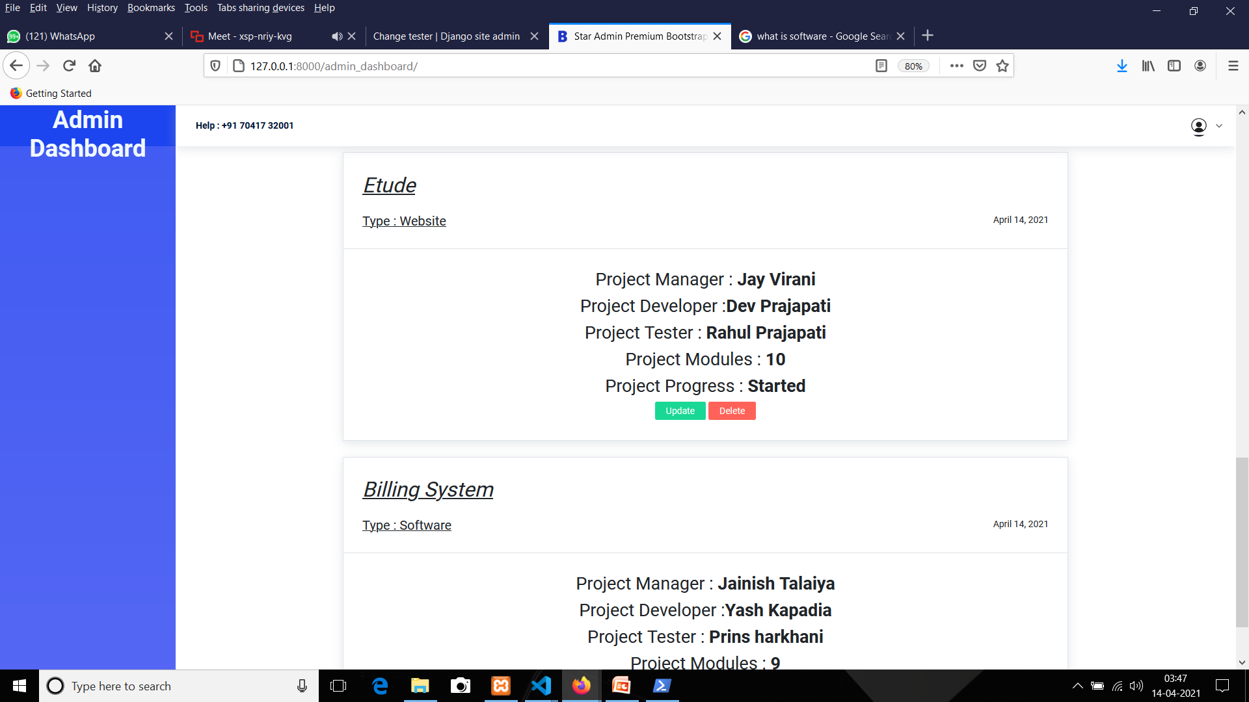
CONTI...

Slide 51
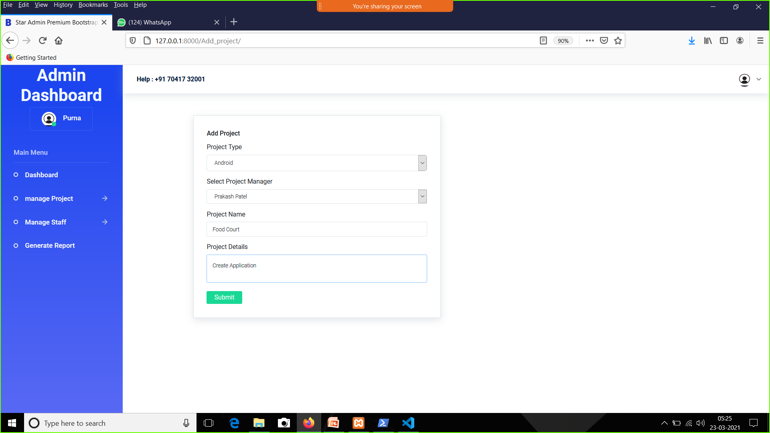
Admin Dashboard→Manage Project→Add Project

Slide 52
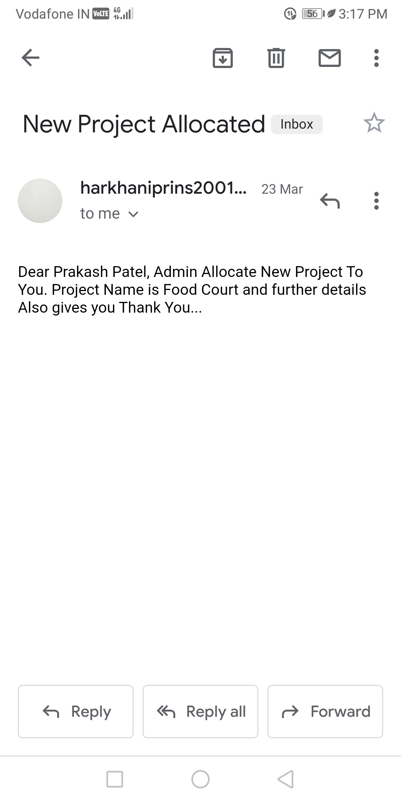
Generate Mail For Add New Project

Slide 53
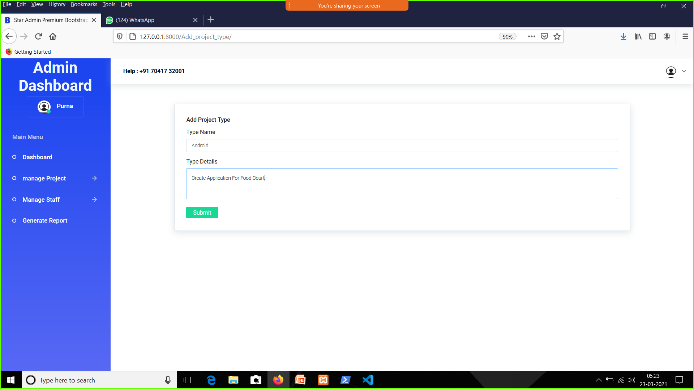
Admin Dashboard→Manage Project→Add Project Type

Slide 54
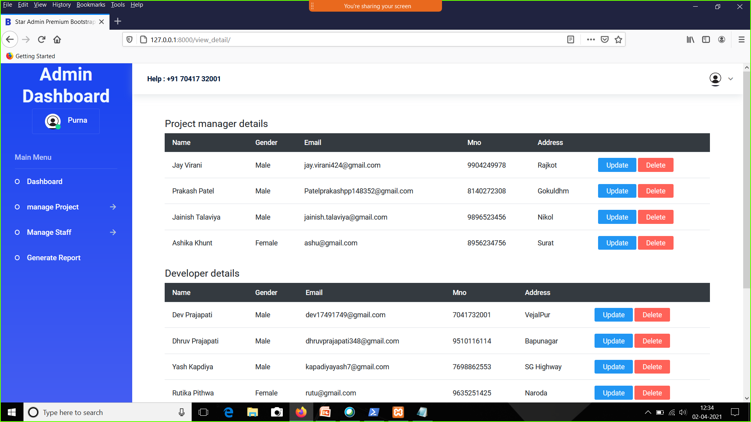
Admin→Manage Staff→View Staff

Slide 55
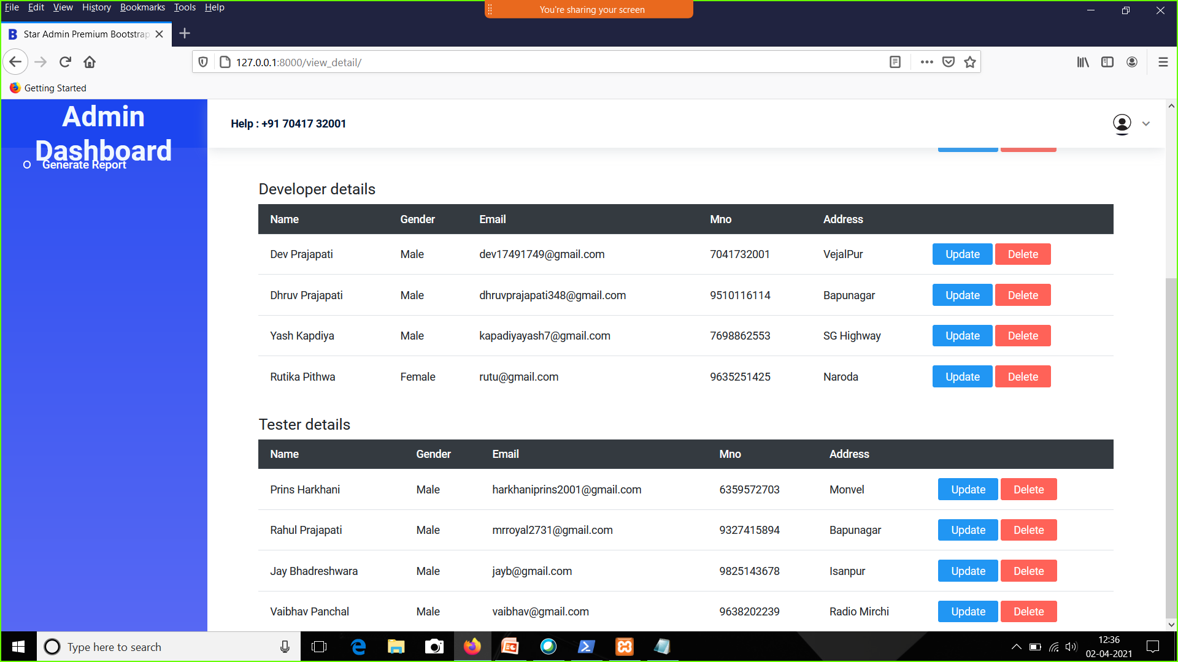
CONTI...

Slide 56
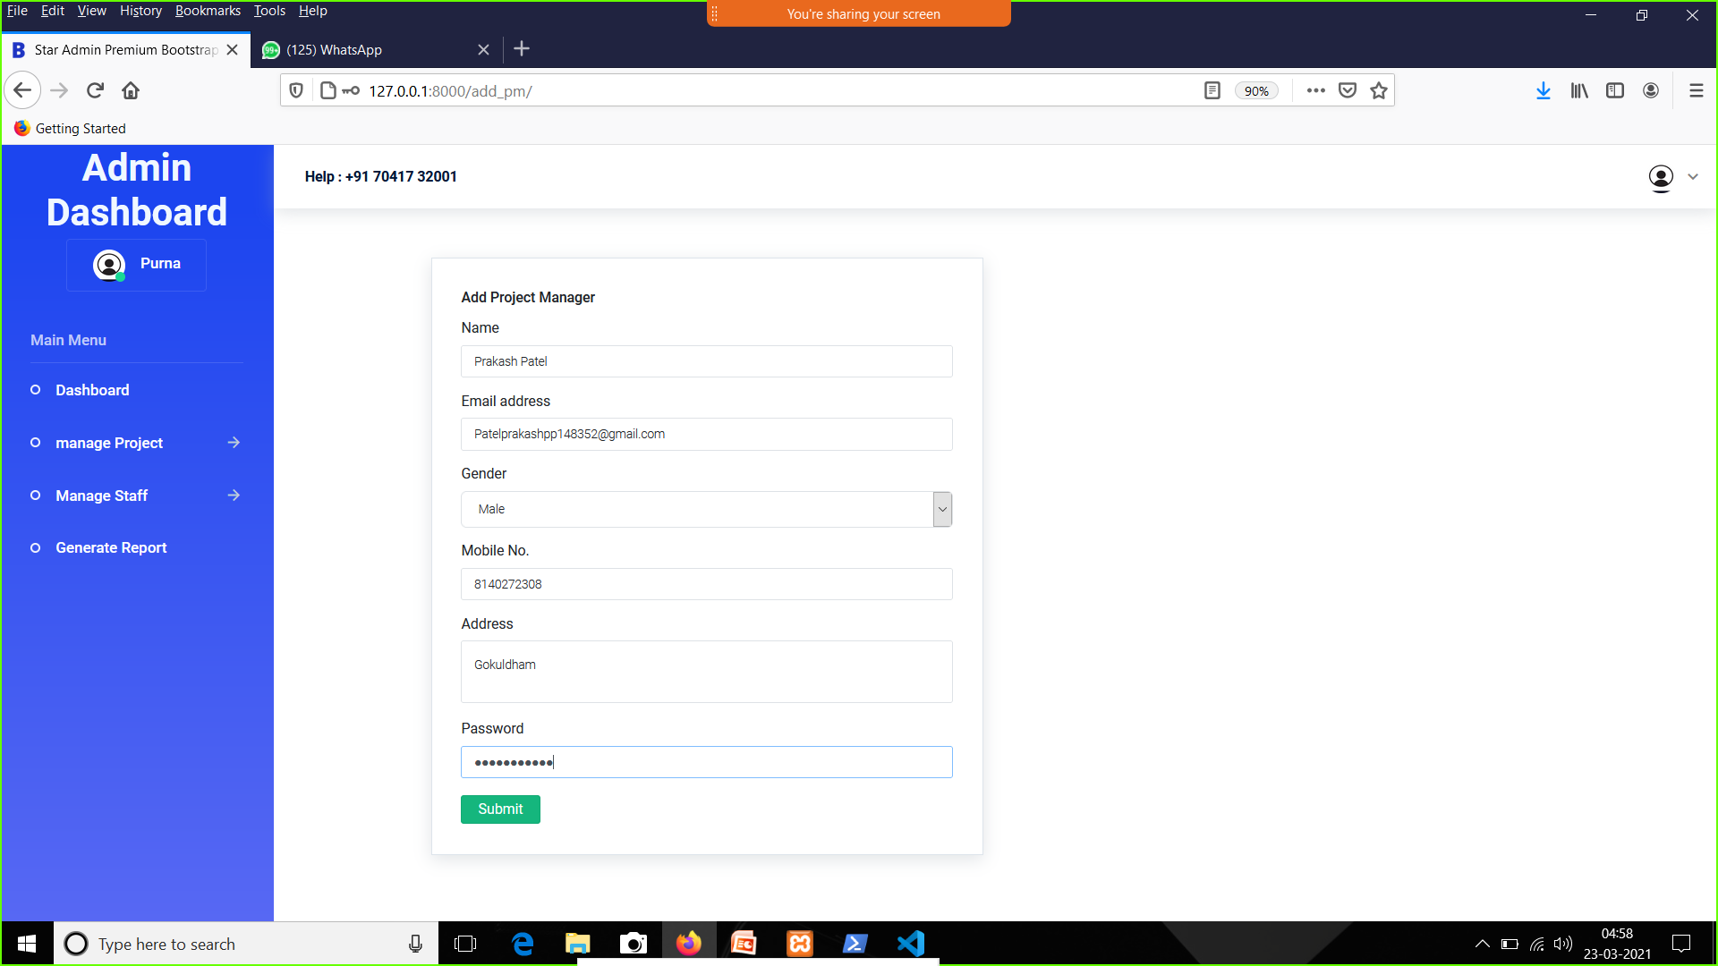
Admin→Manage Staff→Add Project Manager

Slide 57
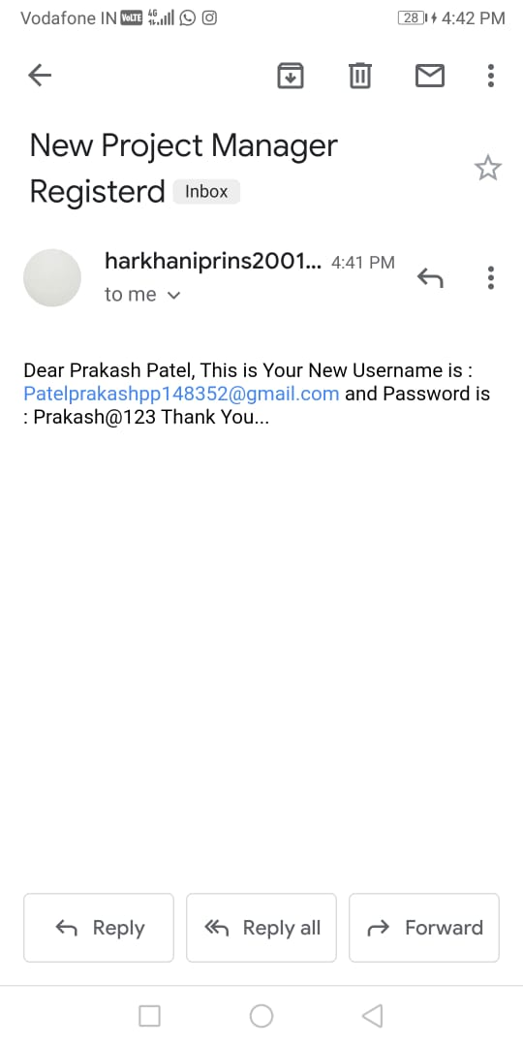
Generate Mail

Slide 58
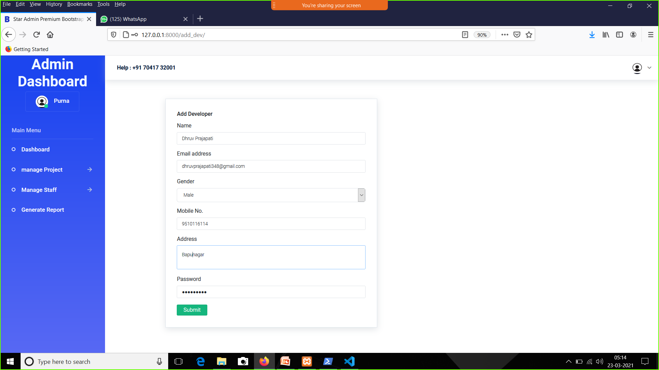
Admin→Manage Staff→Add Developer

Slide 59
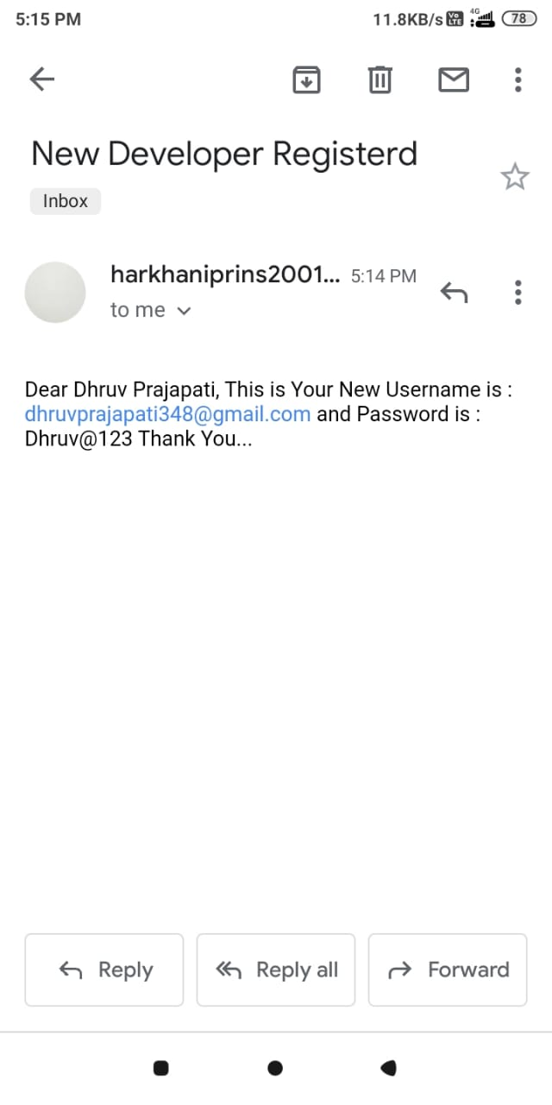
Generate Mail

Slide 60

Admin→Manage Staff→Add Tester

Slide 61
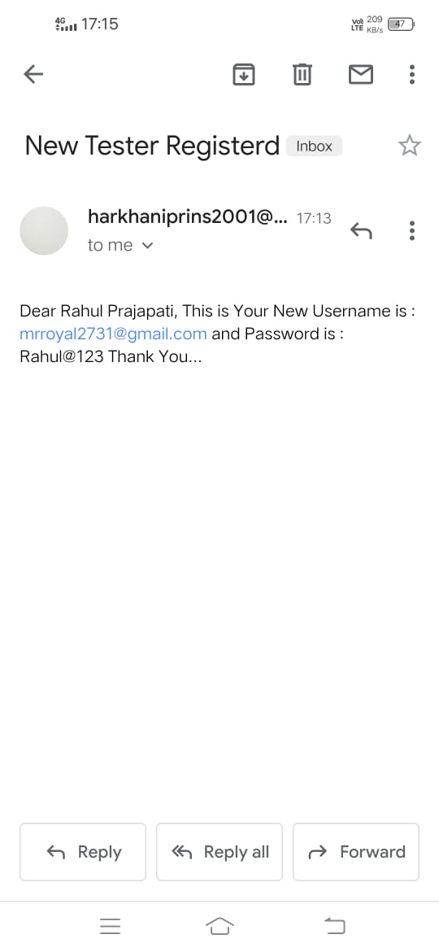
Generate Mail

Slide 62
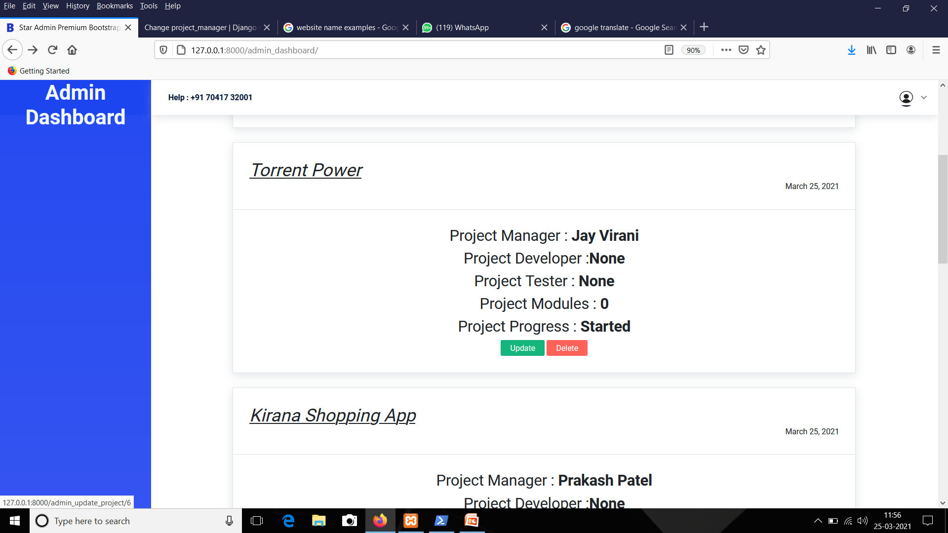
Admin Update A Project

Slide 63
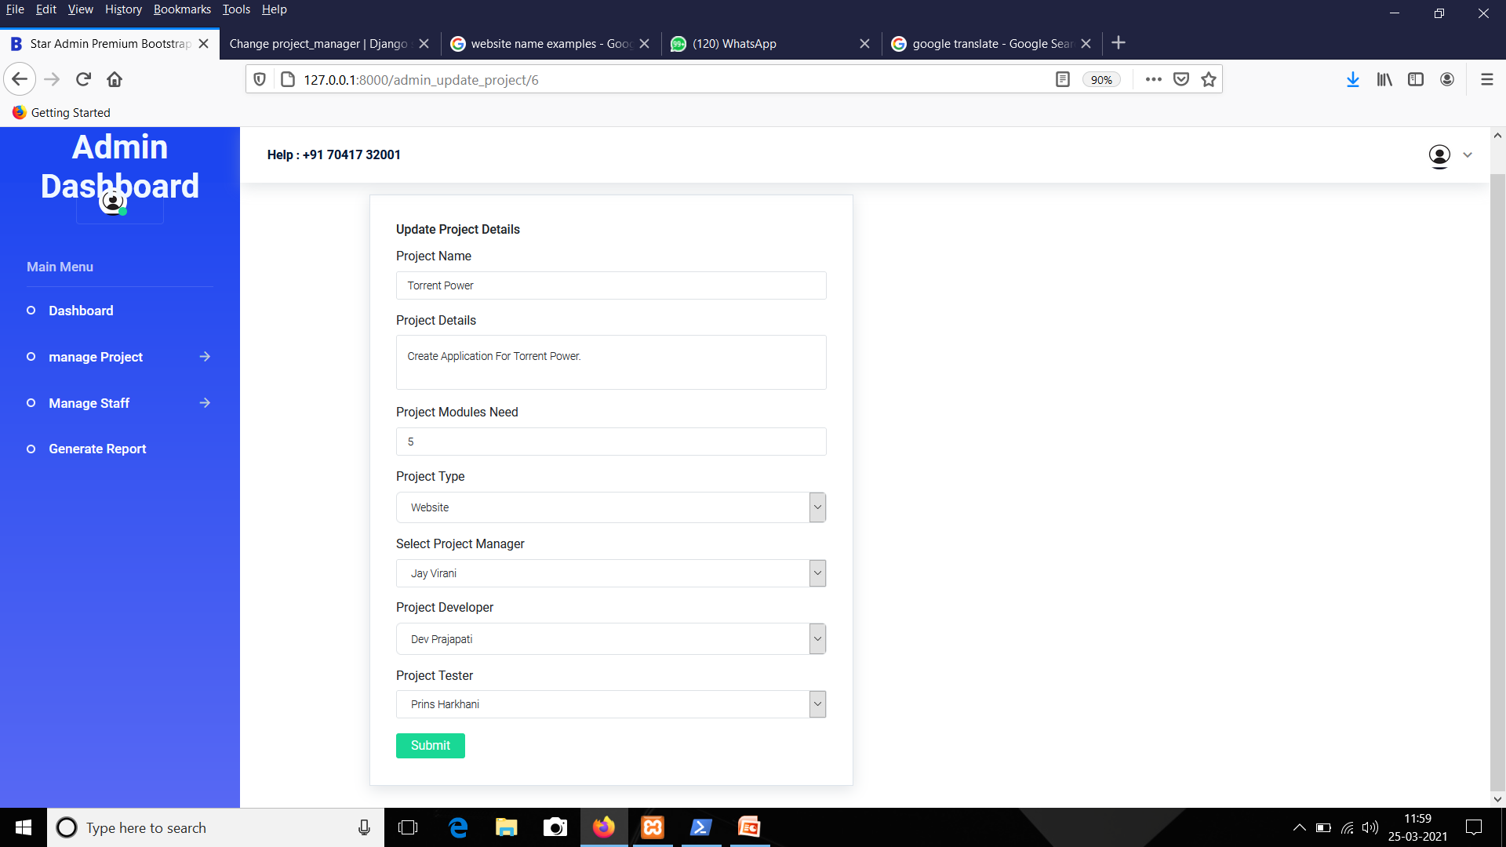
Admin Update Form

Slide 64
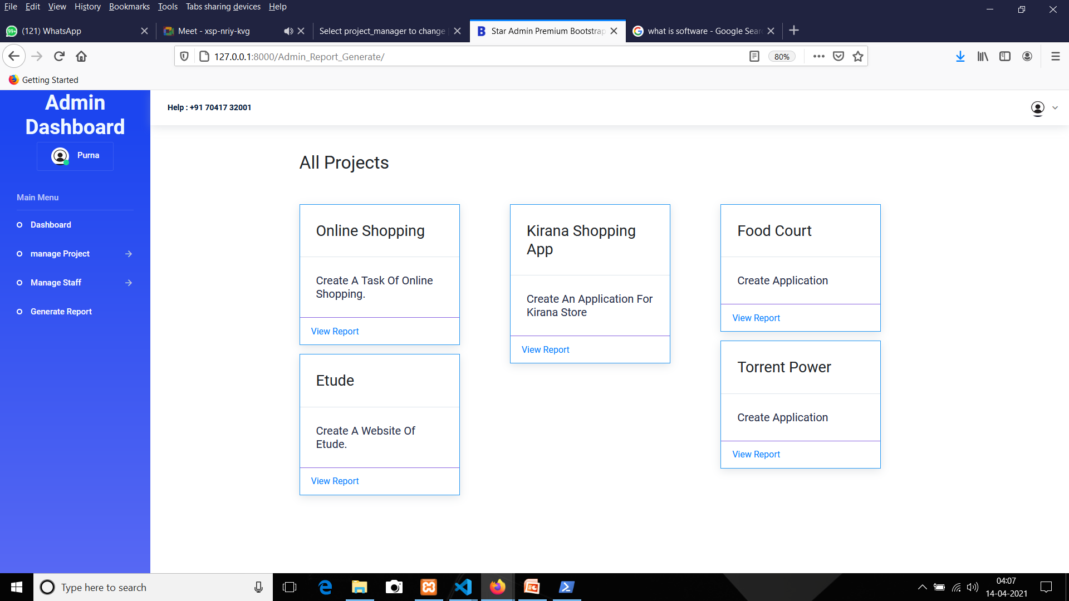
Admin→Generate Report

Slide 65
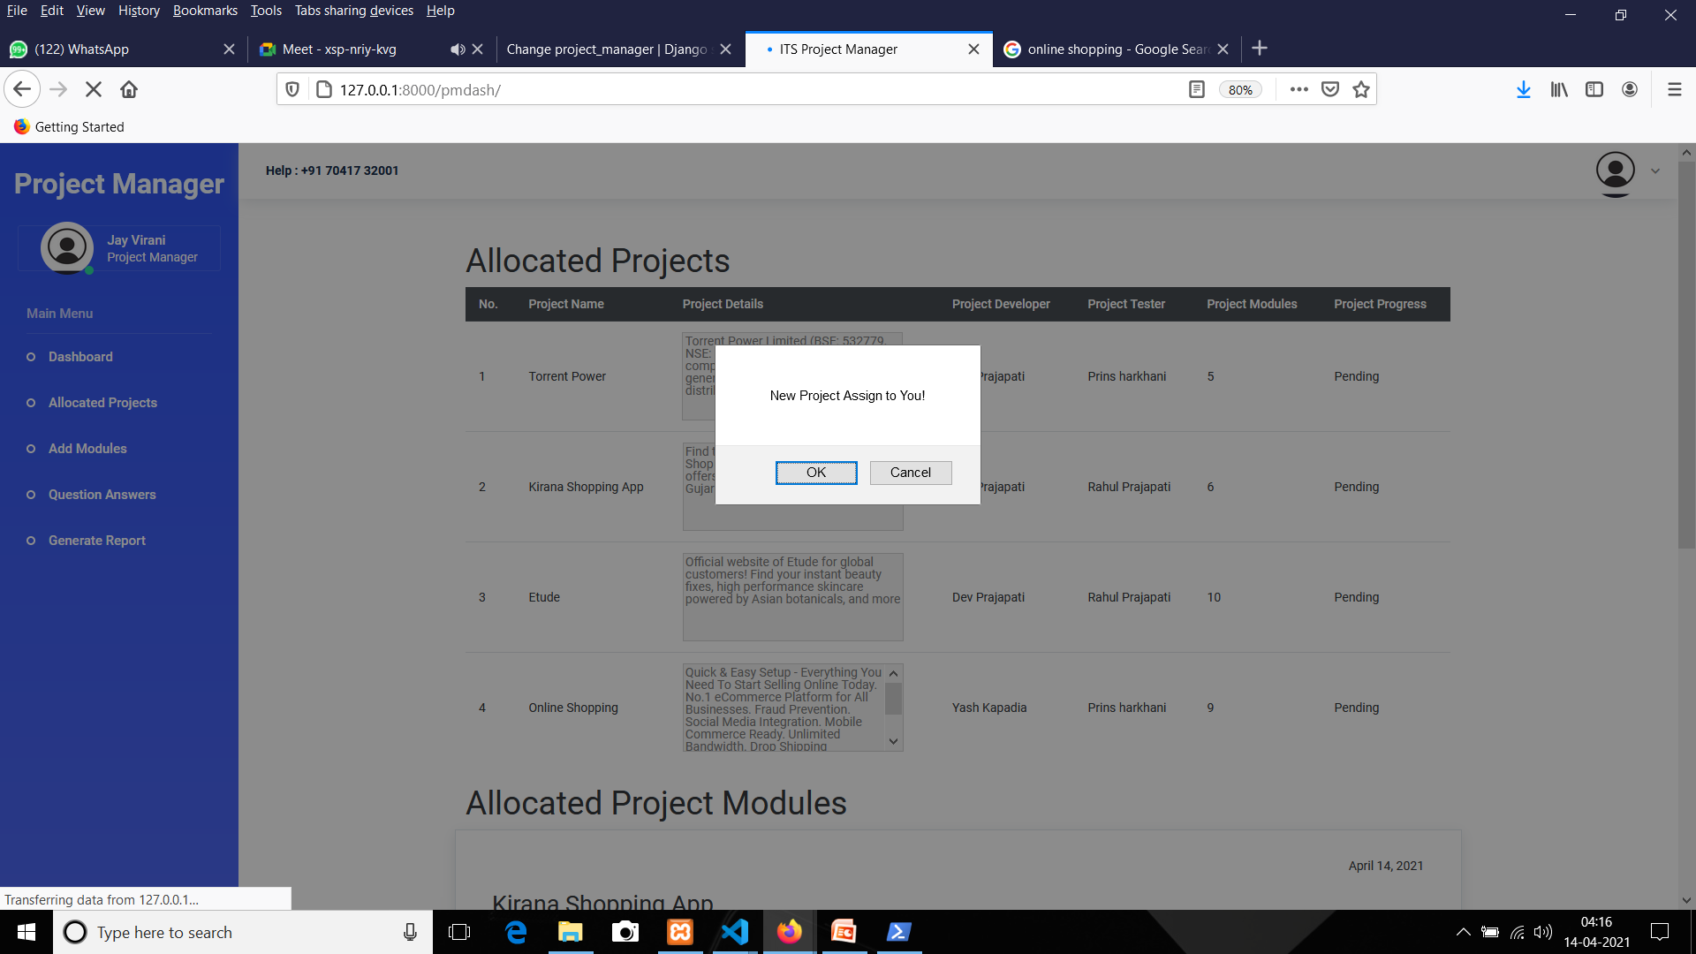
PROJECT MANAGER
Pop-Up Box For Assign Project To Project Manager

Slide 66
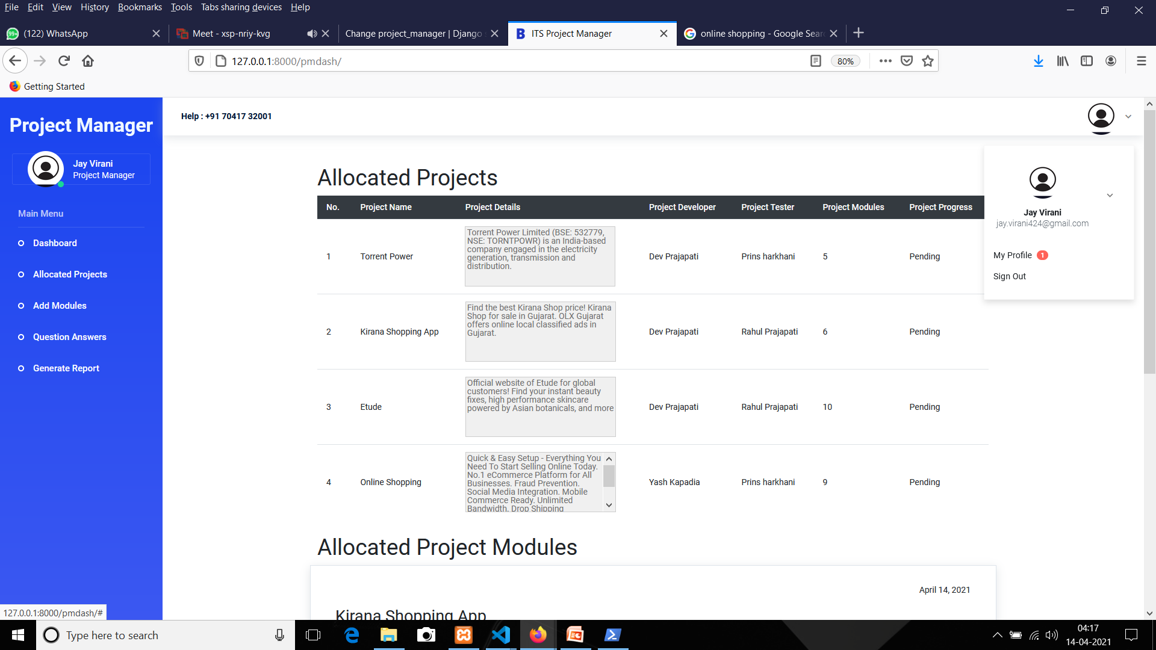
Project Manager→Update Profile

Slide 67
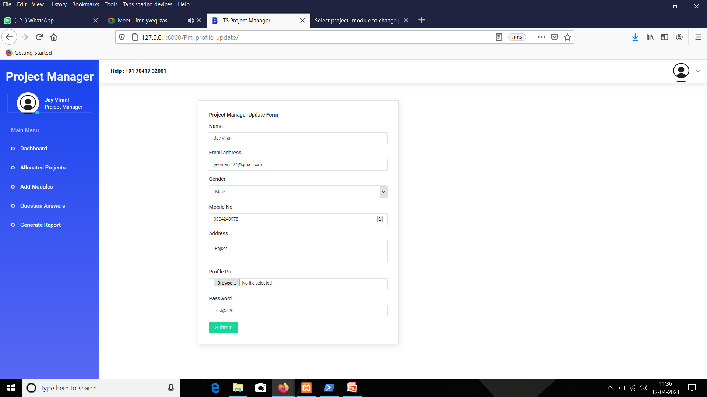
CONTI...

Slide 68
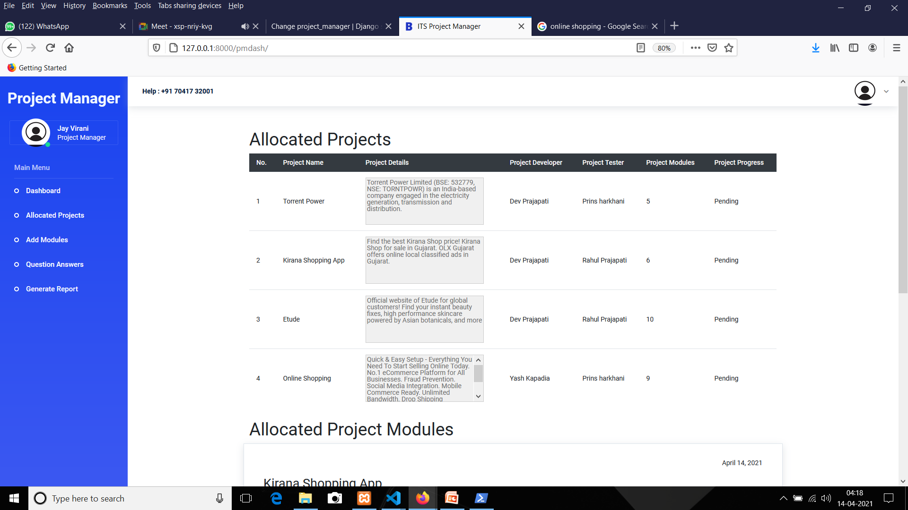
Project Manager→Dashboard

Slide 69
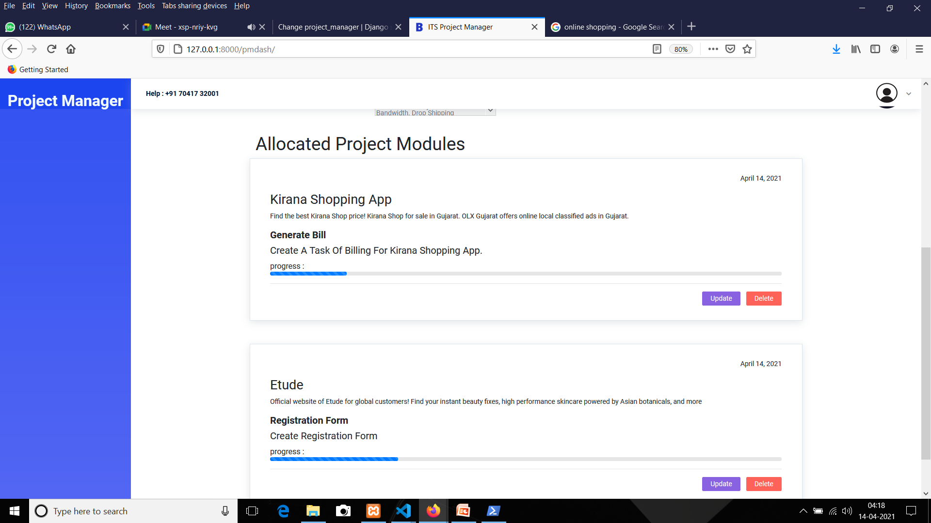
CONTI...

Slide 70
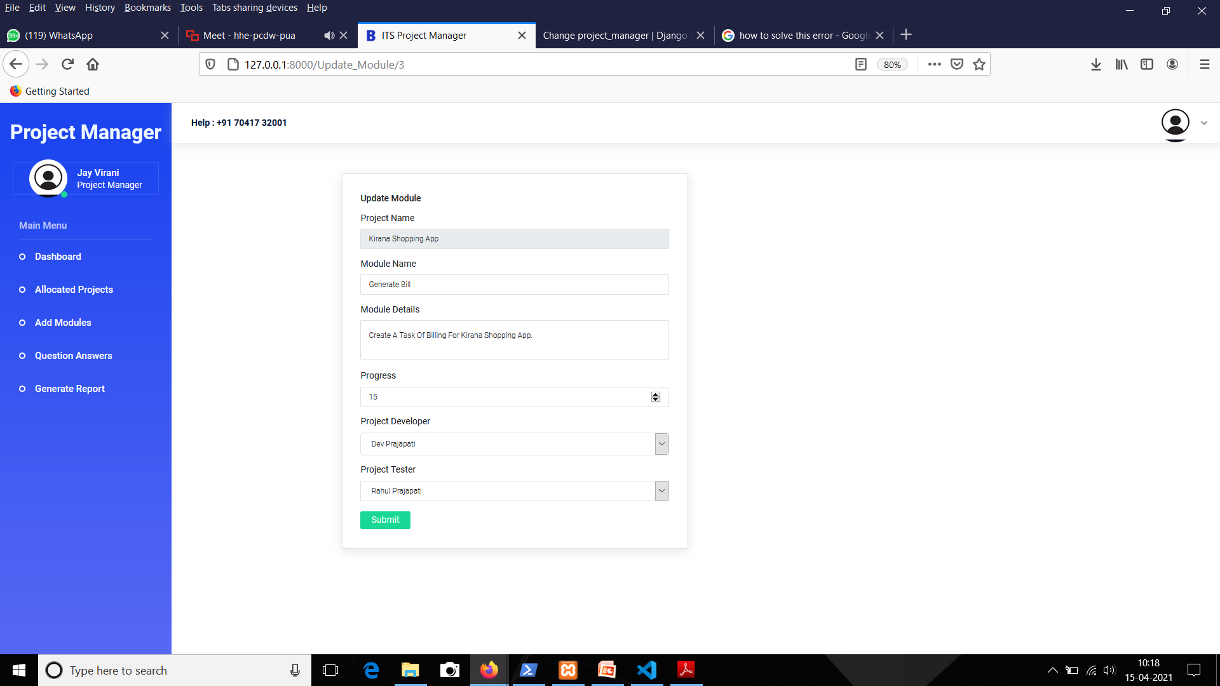
Project Manager→Dashboard→Update Module

Slide 71
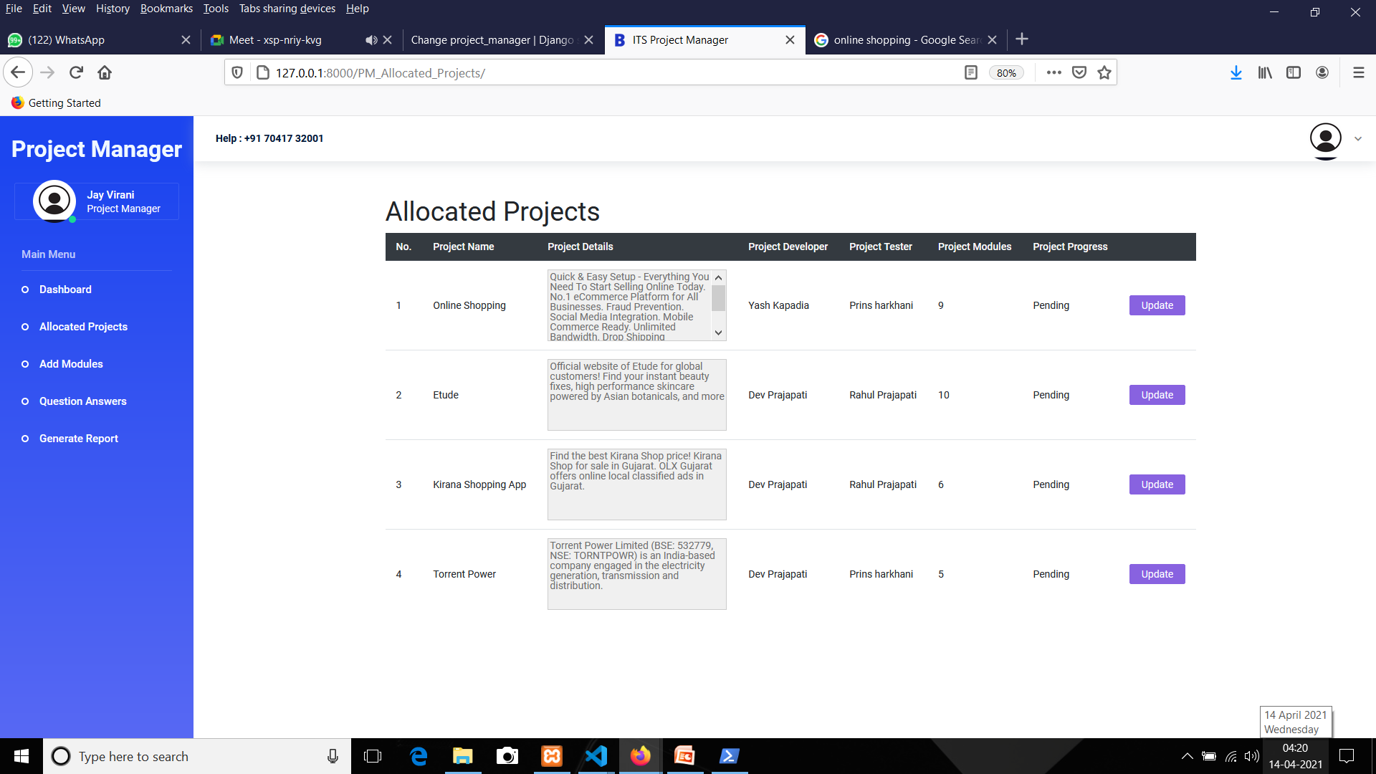
Project Manager→Allocated Project

Slide 72
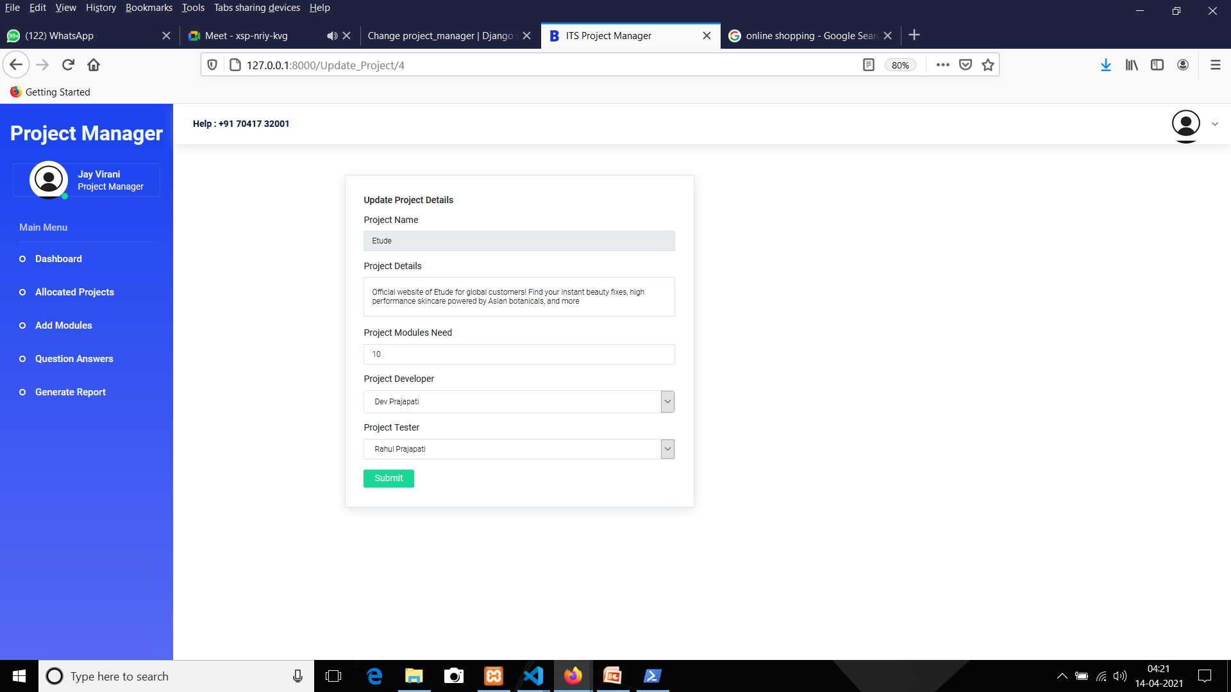
Project Manager Update A Project Details

Slide 73
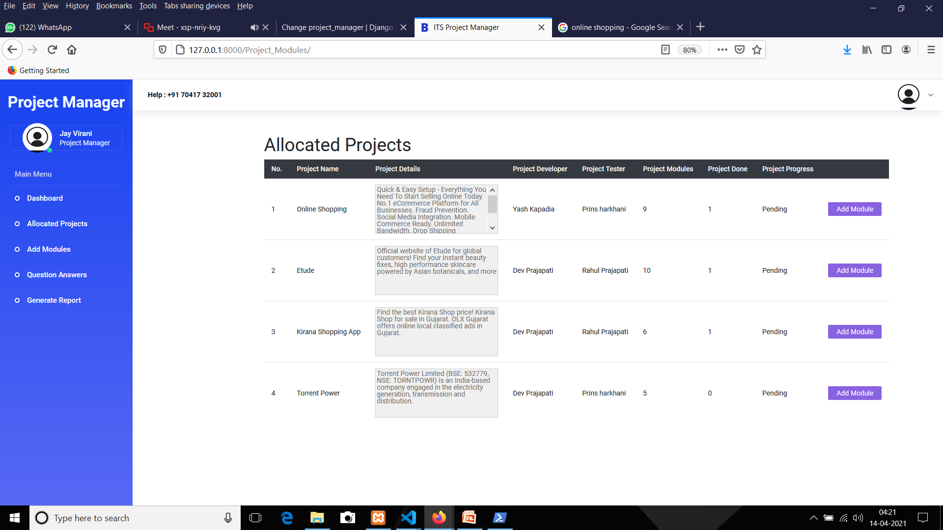
Project Manager→Add Module

Slide 74

Project Manager Add The Module

Slide 75
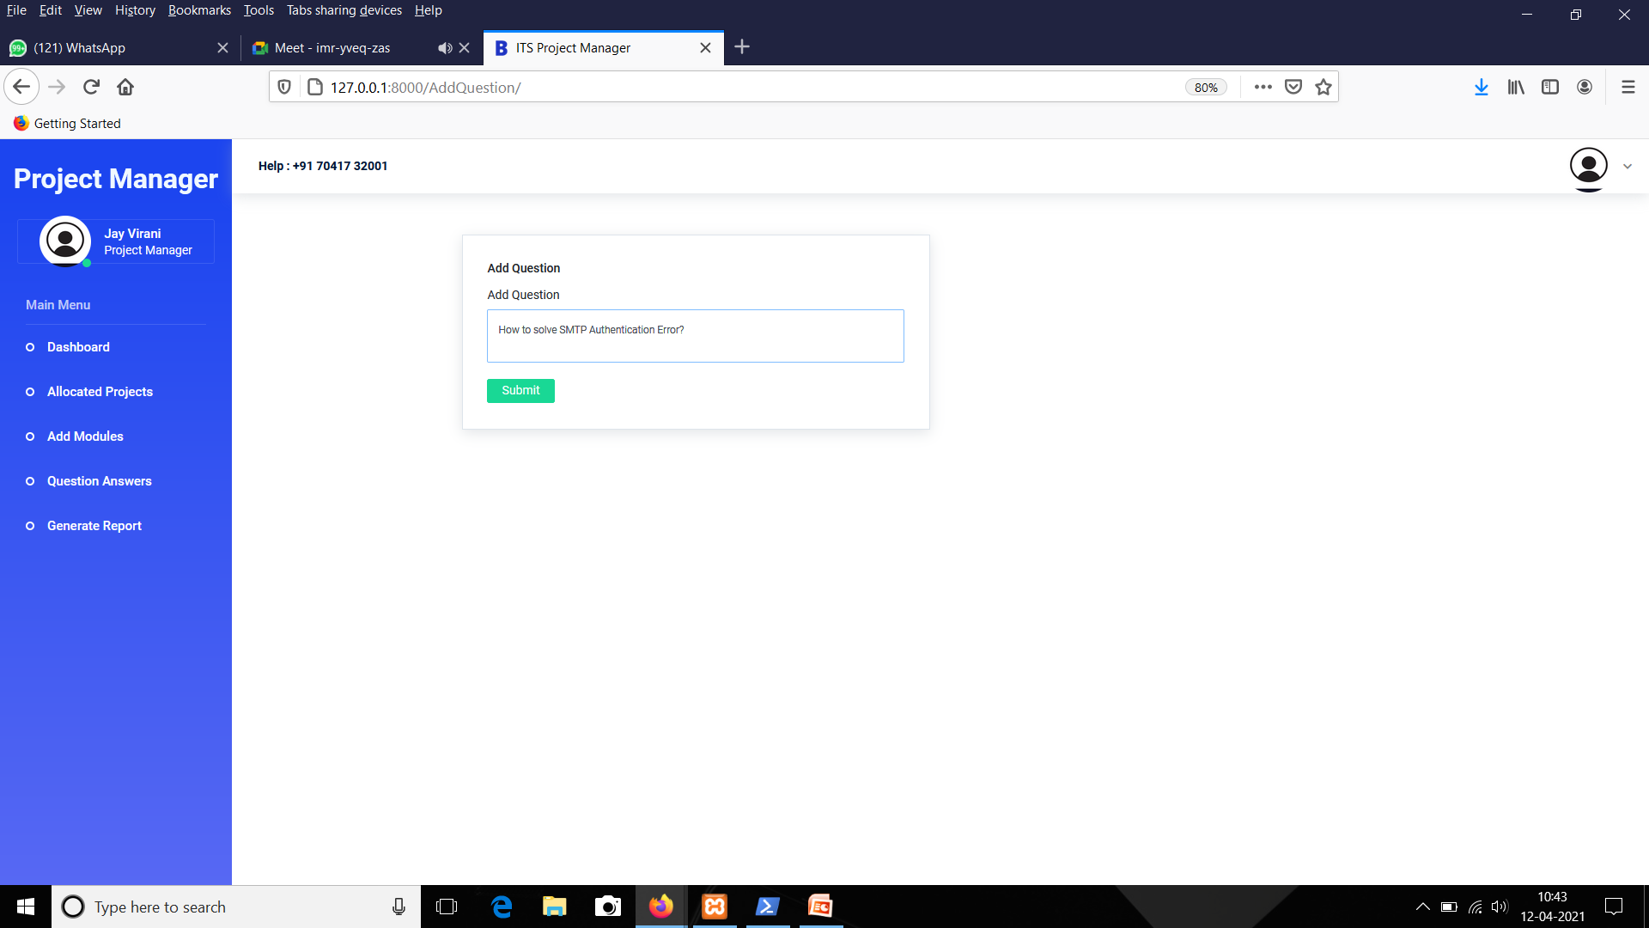
Project Manager→Add Question

Slide 76

Project Manager→Question

Slide 77
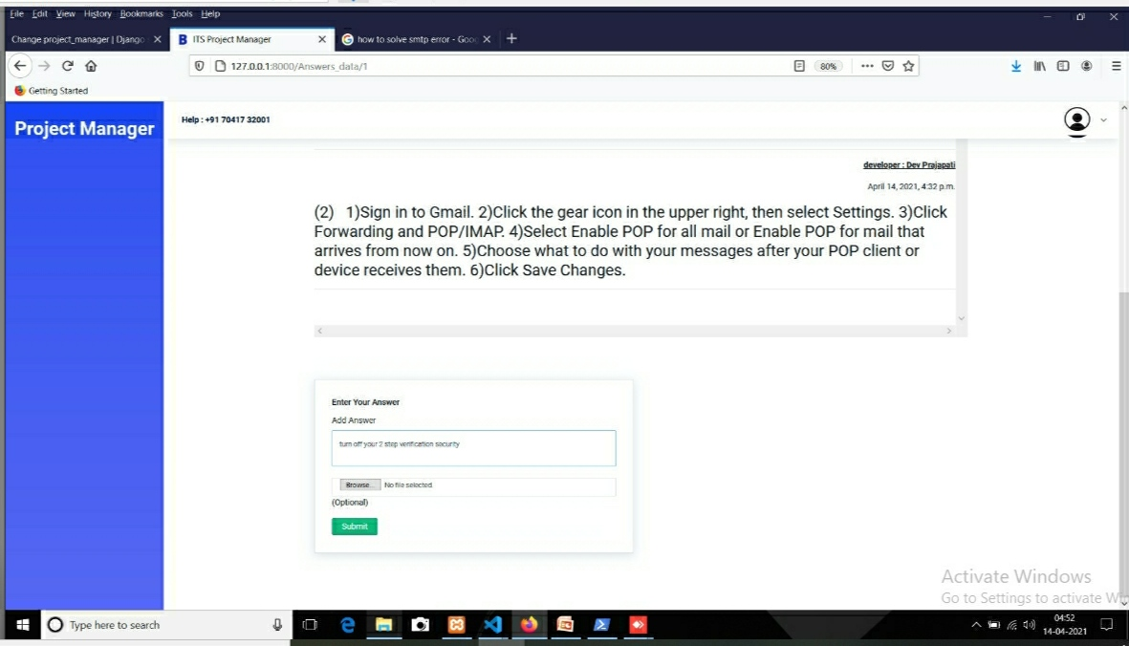
Add Answer

Slide 78
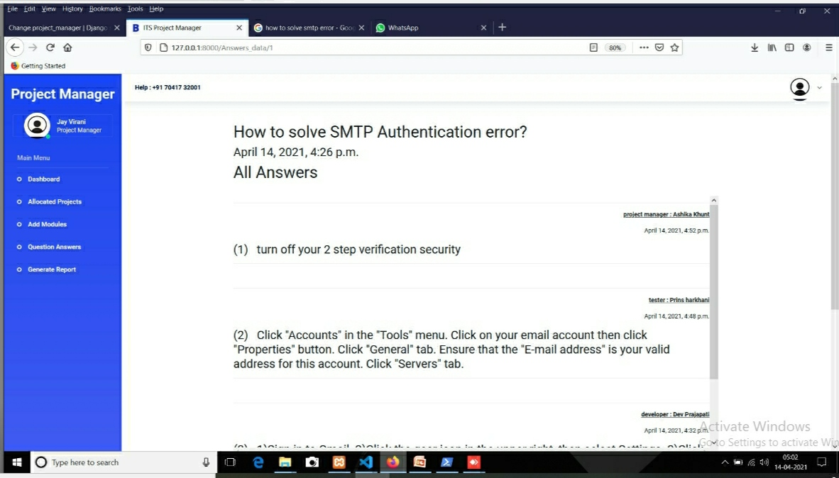
CONTI...

Slide 79
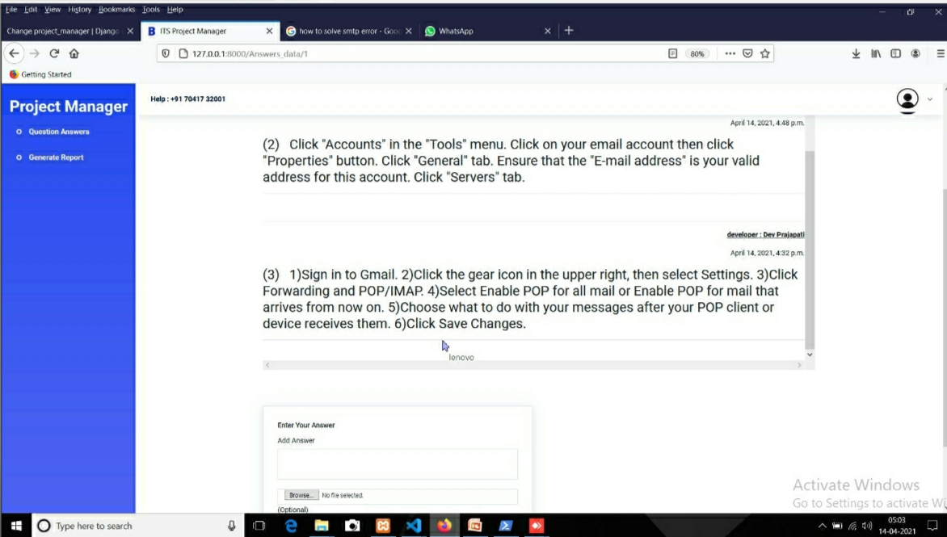
Conti...

Slide 80

Project Manager→Generate Report

Slide 81

DEVELOPER
Pop-Up Box For Assign Project To Developer

Slide 82

Developer→Update Profile

Slide 83

CONTI...

Slide 84

DEVELOPER
Developer→Dashboard

Slide 85

CONTI...

Slide 86

Developer→Modules

Slide 87

Developer→Module Chat

Slide 88

Developer→Add Answer

Slide 89

Conversation Between Developer And Tester

Slide 90

CONTI...

Slide 91

Developer→Add Question

Slide 92

Developer→Question Answers

Slide 93

Developer→Add Answer

Slide 94

CONTI...

Slide 95

Developer→Generate Report

Slide 96

TESTER
Pop-Up Box For Assign Project To Tester

Slide 97

Tester→Update Profile

Slide 98

CONTI...

Slide 99

Tester→Dashboard

Slide 100

CONTI...

Slide 101

Tester→Modules

Slide 102

Tester Update A Project Module

Slide 103

Tester→Module Chat

Slide 104

Tester→Add Answer

Slide 105

Conversation Between Tester & Developer

Slide 106

CONTI...

Slide 107

Tester→Add Question

Slide 108

Tester→Question

Slide 109

Tester→Add Answers

Slide 110

CONTI...

Slide 111

CONTI...

Slide 112

Tester→Generate Report

Slide 113
REPORTS

Slide 114
CONCLUSION
Thus we conclude that we enjoyed very much working on the project “ISSUE TRACKING SYSTEM” our internal guide Prof. Purna Tanna helped us a lot in improving the quality of our project.
This is just the stepping stones for project development there is new paths to be discovered and there are new goals that are to be archived.

Slide 115
THANK YOU

